Slide 1

Welcome!!!
Sign in
Sign up

Slide 2



email
johndoe123@email.com
password
***********
Proceed
Or continue with

Slide 3
Please fill in the needed details
Name
first name
last name
John
Doe
Email
email
johndoe123@email.com
Password
password
***********
Phone number
phone no.
0911-234-567
Sex
Male
Female
Register

Slide 4

You are now registered!
Thank you!
Ok
Notes:
You are registered!

Slide 5
Greetings,
John Doe!
Book now
Check Ticket
History
Log out

Slide 6

Book now
Your current location
auto-generated station
Somewhere Station
Select your destination
select
Ticket type
VIP
REGULAR
Total Amount:
Php. 00.00
Next

Slide 7

Select
Schedule
Train No.
Arrival Time
Select
101
6:00 am
104
7:15 am
110
7: 45 am
115
8:18 am
Next

Slide 8
Upcoming Train Schedule
Train No.
Arrival Time
101
6:00 am
104
7:15 am
110
7: 45 am
115
8:18 am
Next

Slide 9

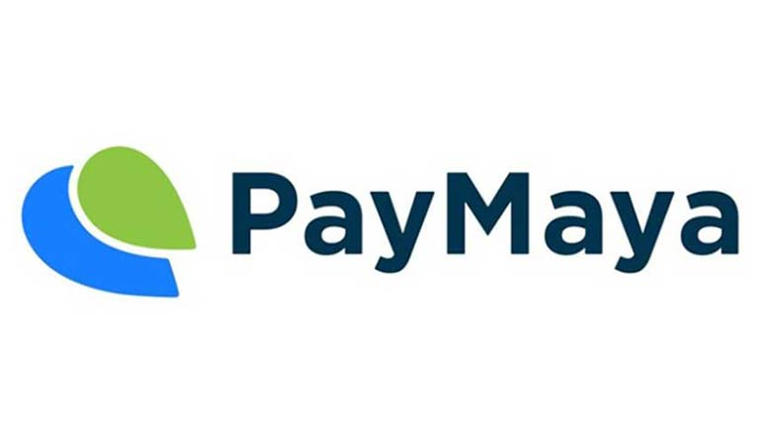
Method of Payment

Slide 10
You are selecting
GCASH as your mode of payment
Are you sure?
YES
NO

Slide 11
Transaction
Details
Destination:
Generated station – Desired station
Ticket Type:
VIP – Php. 20.00
Method of Payment: GCash
Train: 101 | 6:00 am OR 110 | 7:45 am
Done

Slide 12
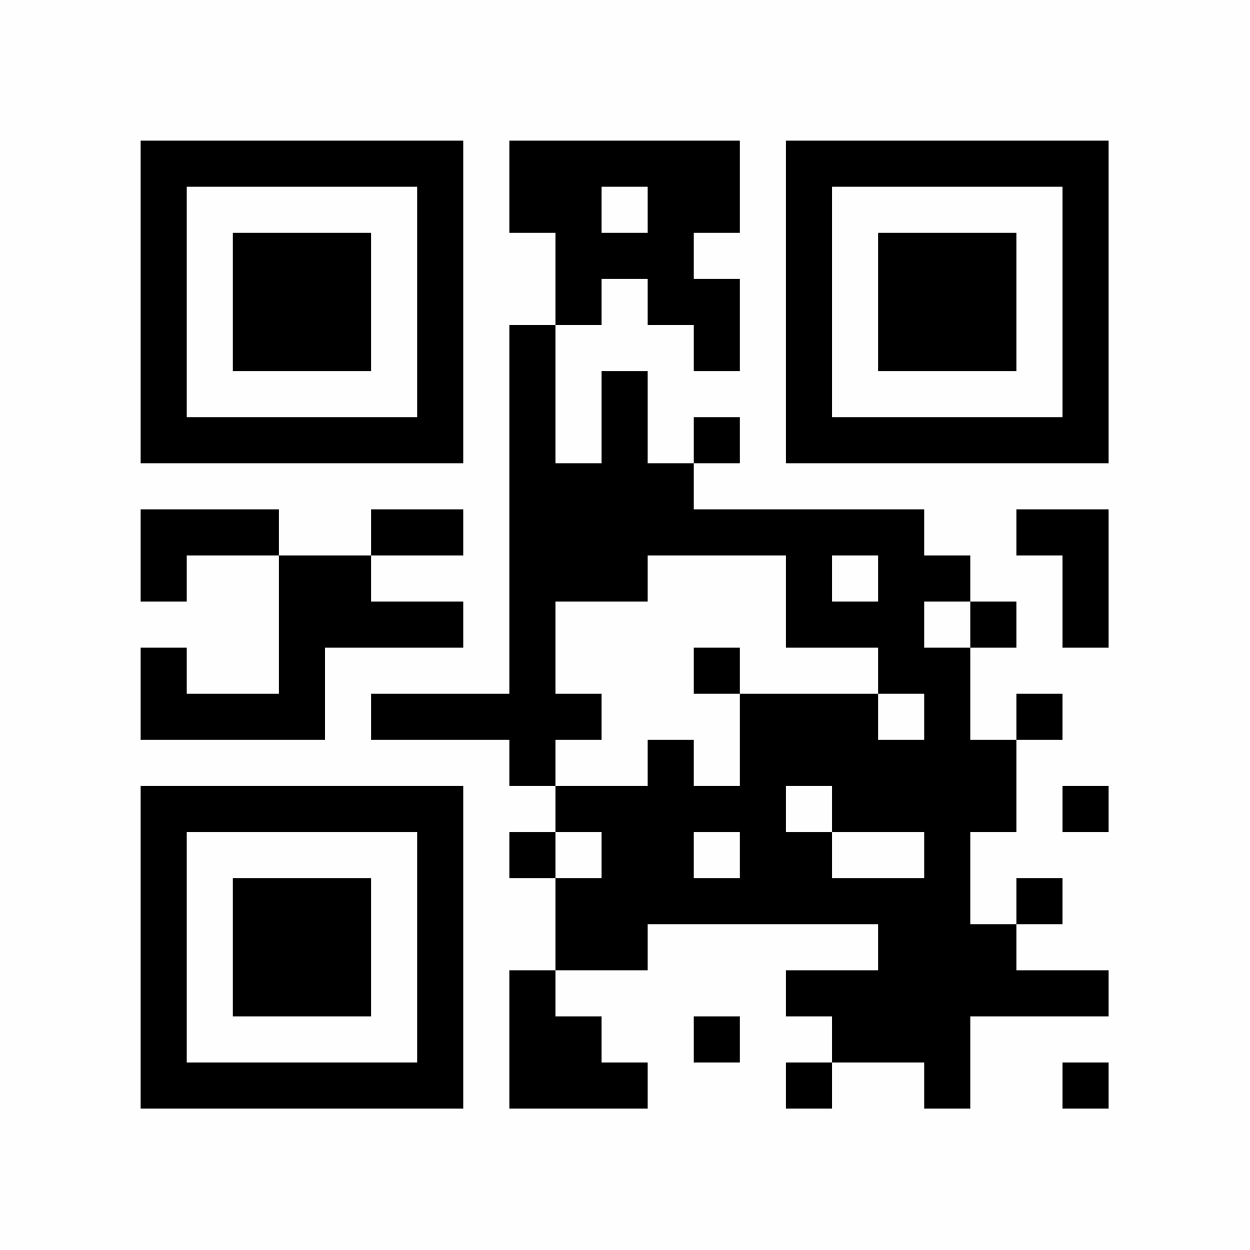
Ticket
Scan to check
ticket details
OK

Slide 13
History
Date
Destination
09/01/19
Station 1 – Station 5
09/05/19
Station 5 – Station 3
09/10/19
Station 5 – Station 10
OK

